Slide 1


How to think about and model effect sizes
Presented by Laura Sità
Supervised by D. Lakens and G. Altoé
Master thesis project
May 17th , 2024

Slide 2
Outline
01
Introduction
02
Research and objectives
03
Methodology
04
Conclusions
Master thesis project
May 17th , 2024

Slide 3
01
Introduction

Slide 4
01
Introduction
A measure of effect size is
a quantitative description of the strength of a phenomenon
It indicates whether an intervention or experimental manipulation has an effect greater than zero or how big the effect is
Laura Sità / Master thesis project
May 17th , 2024
Notes:
(when it is obvious an effect exists)

Slide 5

01
Introduction
For unstandardized effect sizes,
the effect size is expressed on the scale that the measure was collected on
To facilitate a comparison of effect sizes across situations where different measurement scales are used
Standardized effect sizes,
which can be grouped in two families:
the d family (consisting of standardized mean differences)
the r family (measures of strength of association)
Laura Sità / Master thesis project
May 17th , 2024
Notes:
(when it is obvious an effect exists)

Slide 6
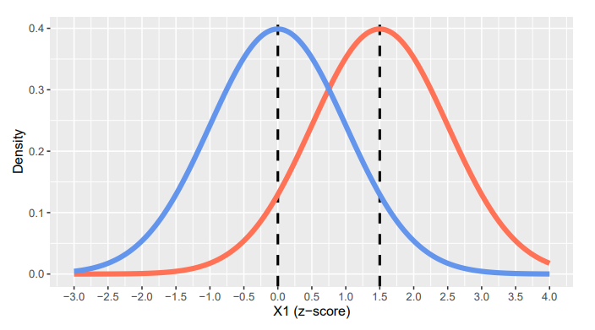
01
Introduction
Here is an example of a visualization of two groups
(“population blue” and “population pink”)
representing Cohen's d = 1.50
Laura Sità / Master thesis project
May 17th , 2024

Slide 7
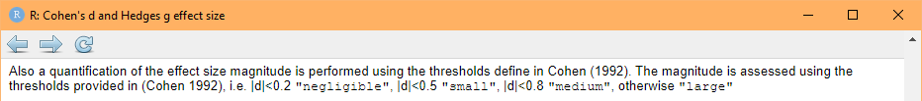
01
Introduction
Effect sizes are underappreciated and often misinterpreted
Common mistakes are to describe the effect size in ways that are uninformative
(e.g. arbitrary standards set by Cohen)
small, medium, large… compared to what/for what purpose?
Looking up the function cohen.d of the r-package {effsize} on the Help:
Laura Sità / Master thesis project
May 17th , 2024

Slide 8
01
Introduction
Some authors have recently suggested new solutions
HILGARD (2021)
Some effect sizes are “too large”
Suggestion. The “largest plausible effect size” is an empirical estimate of how big is too big: effects that exceed this limit are implausible and should be viewed with skepticism
FUNDER AND OZER (2019)
Effect sizes are often misinterpreted: the most common mistakes is to describe them in ways that are uninformative (e.g., using arbitrary standards) or misleading
Suggestion. Effect sizes can be usefully evaluated by comparing them with well-understood benchmarks
Laura Sità / Master thesis project
May 17th , 2024

Slide 9
02
Research and objectives

Slide 10
02
Research and objectives
This project aims to
suggest a better solution to think about effect sizes
show how to implement it in research
Achieving these objectives would lead to
a theoretically more meaningful way to interpret effect sizes
think about practical importance of the effect size
Laura Sità / Master thesis project
May 17th , 2024

Slide 11
02
Research and objectives
1. A better solution to think about effect sizes
Researchers should explicitly model the predicted effect of the independent variable on the dependent variable and consequently test it through their hypotheses
We feel that modelling would prevent researchers
finding effect sizes too big to be true (as Hilgard pointed out)
implicitly assuming that the relationship between variables is linear (e.g. in power analysis)
Laura Sità / Master thesis project
May 17th , 2024

Slide 12
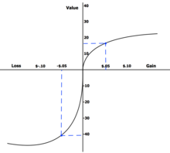
02
Research and objectives
1. An example of explicitly modelling the relationship
In order to test their prospect theory, Tversky and Kahneman proposed a model showing the intensity of the manipulation as a s-shaped and asymmetrical function
They hypothesized that the value function is steeper for losses than gains indicating that losses outweigh gains
Laura Sità / Master thesis project
May 17th , 2024

Slide 13
02
Research and objectives
2. How to implement models in research
When it comes to design a study, we suggest psychologists to
think about variables
research the literature in order to find what could be the effect of their manipulation
create a model representing the expected effect size
formulate an hypothesized effect size that tests the model
Once having (simulated and then) analyzed the data
compare the initial model (from expectations) to the one that describes the observed effect size
interpret the comparison (e.g. if they differ, try to understand why)
Laura Sità / Master thesis project
May 17th , 2024

Slide 14
14
03
Methodology

Slide 15
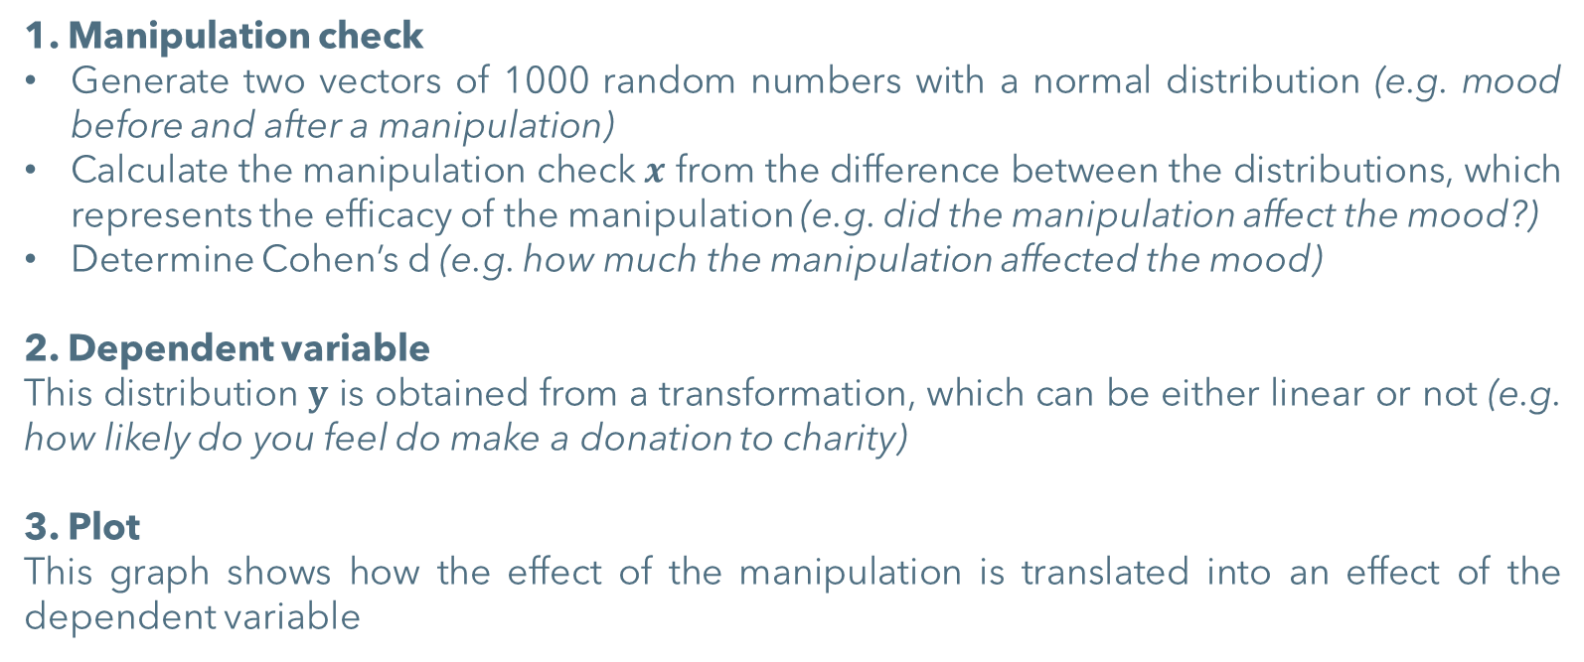
03
Methodology Data simulation
Data simulation using the statistical software R
Laura Sità / Master thesis project
May 17th , 2024

Slide 16
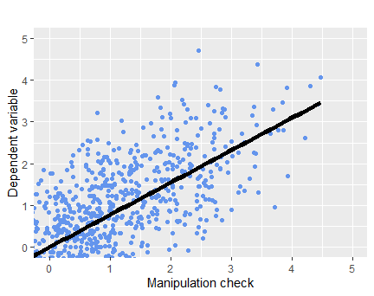
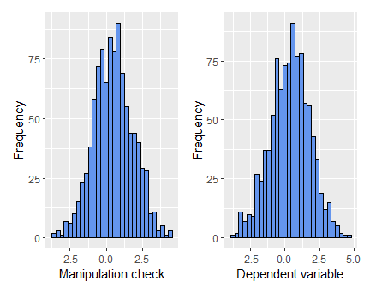
03
Methodology Data simulation
m = 0.474
sd = 1.353
d = 0.473
m = 0.359
sd = 1.434
d = 0.25
Effect of x on y
Laura Sità / Master thesis project
May 17th , 2024

Slide 17
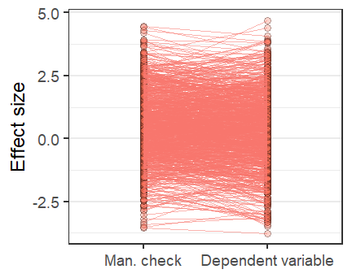
03
Methodology Data simulation
How the manipulation is translated into an effect of the dependent variable
Laura Sità / Master thesis project
May 17th , 2024
Notes:
80% correlation and medium error

Slide 18
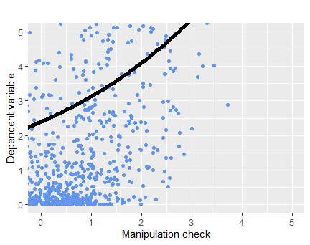
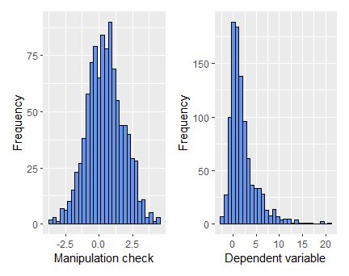
03
Methodology Data simulation
m = 0.474
sd = 1.353
d = 0.473
m = 2.032
sd = 3.016
d = 0.674
Effect of x on y
Laura Sità / Master thesis project
May 17th , 2024

Slide 19
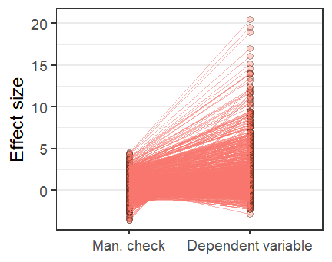
03
Methodology Data simulation
How the manipulation is translated into an effect of the dependent variable
Laura Sità / Master thesis project
May 17th , 2024

Slide 20
03
Methodology Data analysis
Empirical component of the project: analysis of a real data set
1. Find a open-access study where
data are accessible
a manipulation is done and a manipulation check is measured
the dependent variable is related to the manipulation through some psychological mechanism
2. Create a plot that
highlights the relationship between the two distributions of data (subjects’ responses for the manipulation check and the dependent variable)
represents the links between each couple of responses within every subject
3. Expect to find
a correspondence within each couple of data
that would be graphically represented by a series of straight lines
Laura Sità / Master thesis project
May 17th , 2024

Slide 21
03
Methodology Data analysis
We are looking for studies
with an available data set where the researchers conducted
a manipulation on the subjects and collect data to check if it happened as planned (manipulation check)
a measurement of the dependent variable, related to the manipulation through some psychological mechanism
Laura Sità / Master thesis project
May 17th , 2024

Slide 22
22
04
Conclusions

Slide 23
04
Conclusions
23
Key points
This work is a step forward to a meaningful interpretation because it suggests
an alternative way to think about expected effect sizes
to explicitly model the relationship when designing their study makes researchers think thoroughly about the effect they are studying
This procedure can be applied within both the frequentist and bayesian approach
Laura Sità / Master thesis project
May 17th , 2024

Slide 24
04
Conclusions
24
Future research
Work on setting lower and upper bounds (like Hilgard suggested with estimate of the largest plausible effect size)
Spread the procedure of explicit modelling with researchers in the various fields of psychology (e.g. predict the effect of a clinical intervention)
Anything else ?
Laura Sità / Master thesis project
May 17th , 2024

Slide 25
04
Conclusions
25
The code is available on RPubs
https://rpubs.com/laurasita/1185335
Thank you for your attention
Any questions or feedback?
Email address: laura.sita@studenti.unipd.it
Laura Sità / Master thesis project
May 17th , 2024

