Slide 1

Change of $d$-irection:
Alternative methods for meta-analysis in psychology
Irene Alfarone, Matthias Gondan
Institut für Psychologie, Universität Innsbruck
Psicostat Meeting, 7th March 2025

Slide 2
What is a Meta-Analysis?
A statistical technique that quantitatively summarizes the results of multiple studies to derive a more precise effect estimate
Widely used in psychology

Slide 3
The problem of Standardized Mean Differences
The problem of different scales is usually “solved” using dimensionless measures such as Standardized Mean Differences (SMD)
On PsycInfo there is record of 21,714 meta-analyses with results on SMD*
* TI("meta-analysis" OR "metaanalysis" OR "metanalysis" OR "meta analysis") AND AB("systematic review" OR "meta-analysis" OR "metaanalysis" OR "meta analysis" AND "cohen's d" OR "hedges' g" OR "standardized mean difference" OR "smd" OR "glass delta" OR "glass d"))

Slide 4
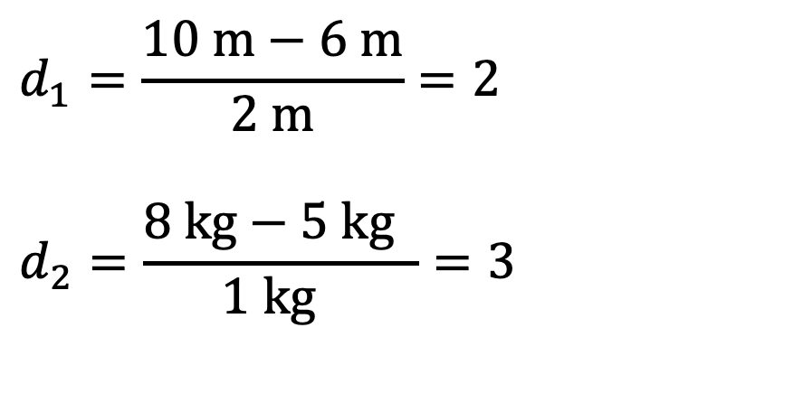
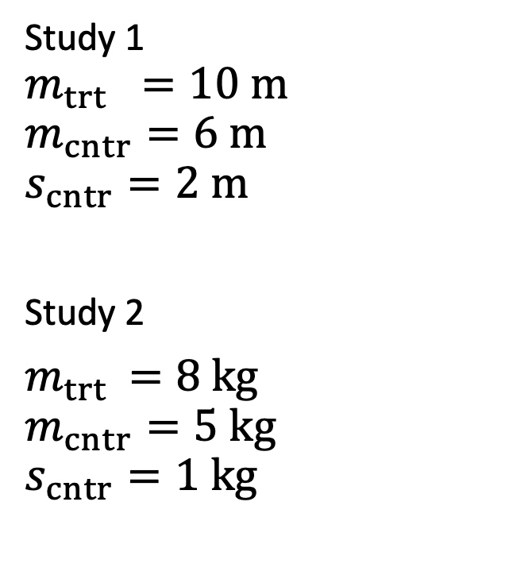
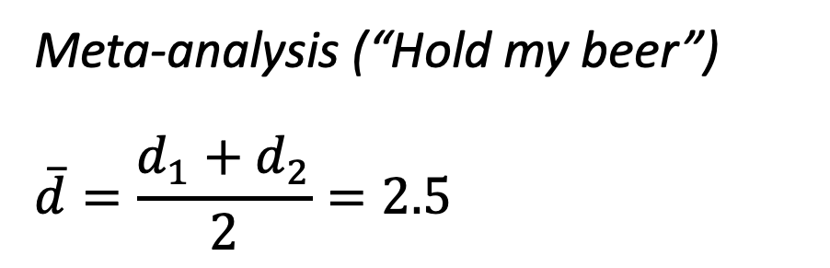
What is the average of 2 m and 3 kg?
Study 1
$$m_{trt} =10 m$$
$$m_{cntr}=6 m$$
$$s_{cntr}=2 m$$
Study 2
$m_{trt }=8 kg$
$$m_{cntr}=5 kg$$
$$s_{cntr}=1 kg$$
$$d_{1}=\frac{10 m−6 m}{2 m}=2$$
$$d_{2}=\frac{8 kg−5 kg }{1 kg }=3$$
Meta-analysis (“Hold my beer”)
$$\overline{d}=\frac{d_{1}+d_{2}}{2}=2.5$$

Slide 5
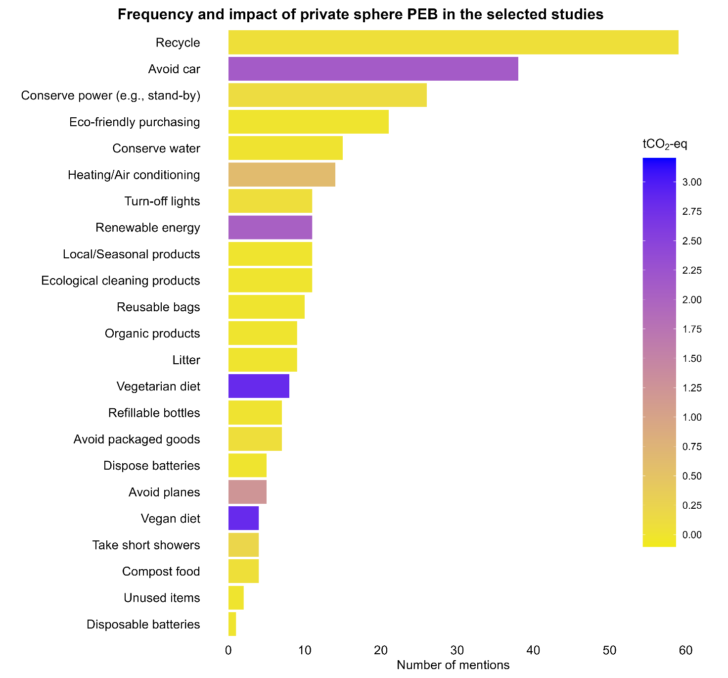
Environmental Psychology

Slide 6
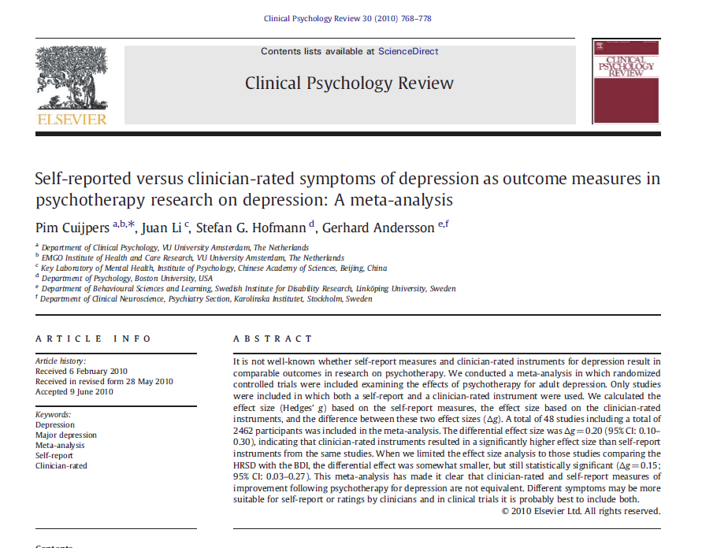
What is the average of a CR and a SR?
“This meta-analysis has made it clear that clinician-rated and self-report measures of improvement following psychotherapy for depression are not equivalent.”

Slide 7
Alternative solutions
“[…] many clinical studies have more than one outcome variable; this is the norm rather than the exception. These variables are seldom independent and so each must carry some information about the others. If we can use this information, we should.”
Bland (2011, p. 2)
Multivariate meta-analysis
Structural Equation Model (SEM) meta-analysis
Meta-analysis as a missing data problem

Slide 8
Simulation study
50 Randomized Control Trials with a two-group comparison
Latent illness measured on 2 scales
  Clinician rating (CR)
  Self-report (SR)
Illness is affected by the age and gender of the individual
Illness is measured at T0 with CR and SR scales
50,000 observations

Slide 9

Bivariate random-effects model
$${\hat{θ}}_{s1}=θ_{1}+ζ_{s1} +ε_{s1}$$
$${\hat{θ}}_{s2}=θ_{2}+ ζ_{s2}+ ε_{s2}$$
$$\left(\begin{matrix}ζ_{s1} \\ ζ_{s2}\end{matrix}\right) \sim N \left\{0= \left(\begin{matrix}0 \\ 0\end{matrix}\right), T= \left(\begin{matrix}τ_{1}^{2} & τ_{12} \\ τ_{21} & τ_{2}^{2}\end{matrix}\right)\right\}$$
$$\left(\begin{matrix}ε_{s1} \\ ε_{s2}\end{matrix}\right) \sim N \left\{0= \left(\begin{matrix}0 \\ 0\end{matrix}\right), Ω_{s}= \left(\begin{matrix}σ_{s1}^{2} & σ_{s12} \\ σ_{s21} & σ_{s2}^{2}\end{matrix}\right)\right\}$$
$Ω_{s}$ is the within-study covariance matrix
$T$ is the between-study covariance matrix
Analysis performed with mixmeta (Gasparrini, 2022)

Slide 10
Within and between study correlation
The within study correlation is assumed to be known, as it arises because of the correlation of a participant’s pair of responses.
The between study correlation is not known and has to be estimated when fitting the multivariate model. It indicates how the underlying true values are related across studies.
Riley et al. (2007)

Slide 11
MVMA as Structural Equation Model
T0 on CR
EOT on CR
Therapy
Illness at T0
End Of Therapy
T0 on SR
EOT on SR

Slide 12
Structural Equation Modeling
There are two mathematically equivalent approaches to handle multivariate effect sizes with known covariance matrices in SEM (Cheung, 2008):
  Using transformed effect sizes
  Using FIML and definition variables
Notes:
These manipulations are necessary because SEM usually assumes that the data are independent and identically distributed. However, the effect sizes in MVMA are distributed with known covariance matrices. In principle effect sizes should be independent and identically distributed.

Slide 13
Structural Equation Modeling
We performed the analyses using the metaSEM package (Cheung, 2008), that uses definition variables and FIML
Definition variables are “observed variables that can be used to impose values on parameters in a model”
Definition variables are used to impose the known conditional
sampling covariance matrices of each study

Slide 14
… and if we don’t have within-study correlations?

Slide 15
Riley Method and Robust Variance Estimator
Riley et al. (2008) and Hong et al. (2015) have developed method that allows performing multivariate MA when within-study correlations are unknown
They use a Huber sandwich estimator which combines an empirical version of the variance estimation in a sandwich form. This estimator is asymptotically correct even when the model is misspecified.
It works with more than 50 studies.

Slide 16
Comparison – complete case analysis
 | Univariate |  | Multivariate |  | SEM |  | Riley Method
Variable | Estimate | Std.Err. | Estimate | Std.Err. | Estimate | Std.Err. | Estimate | Std.Err.
CR | 3.329 | 0.196 | 3.330 | 0.196 | 3.330 | 0.196 | 3.331 | 0.197
SR | 3.378 | 0.205 | 3.382 | 0.205 | 3.382 | 0.205 | 3.381 | 0.205

Slide 17
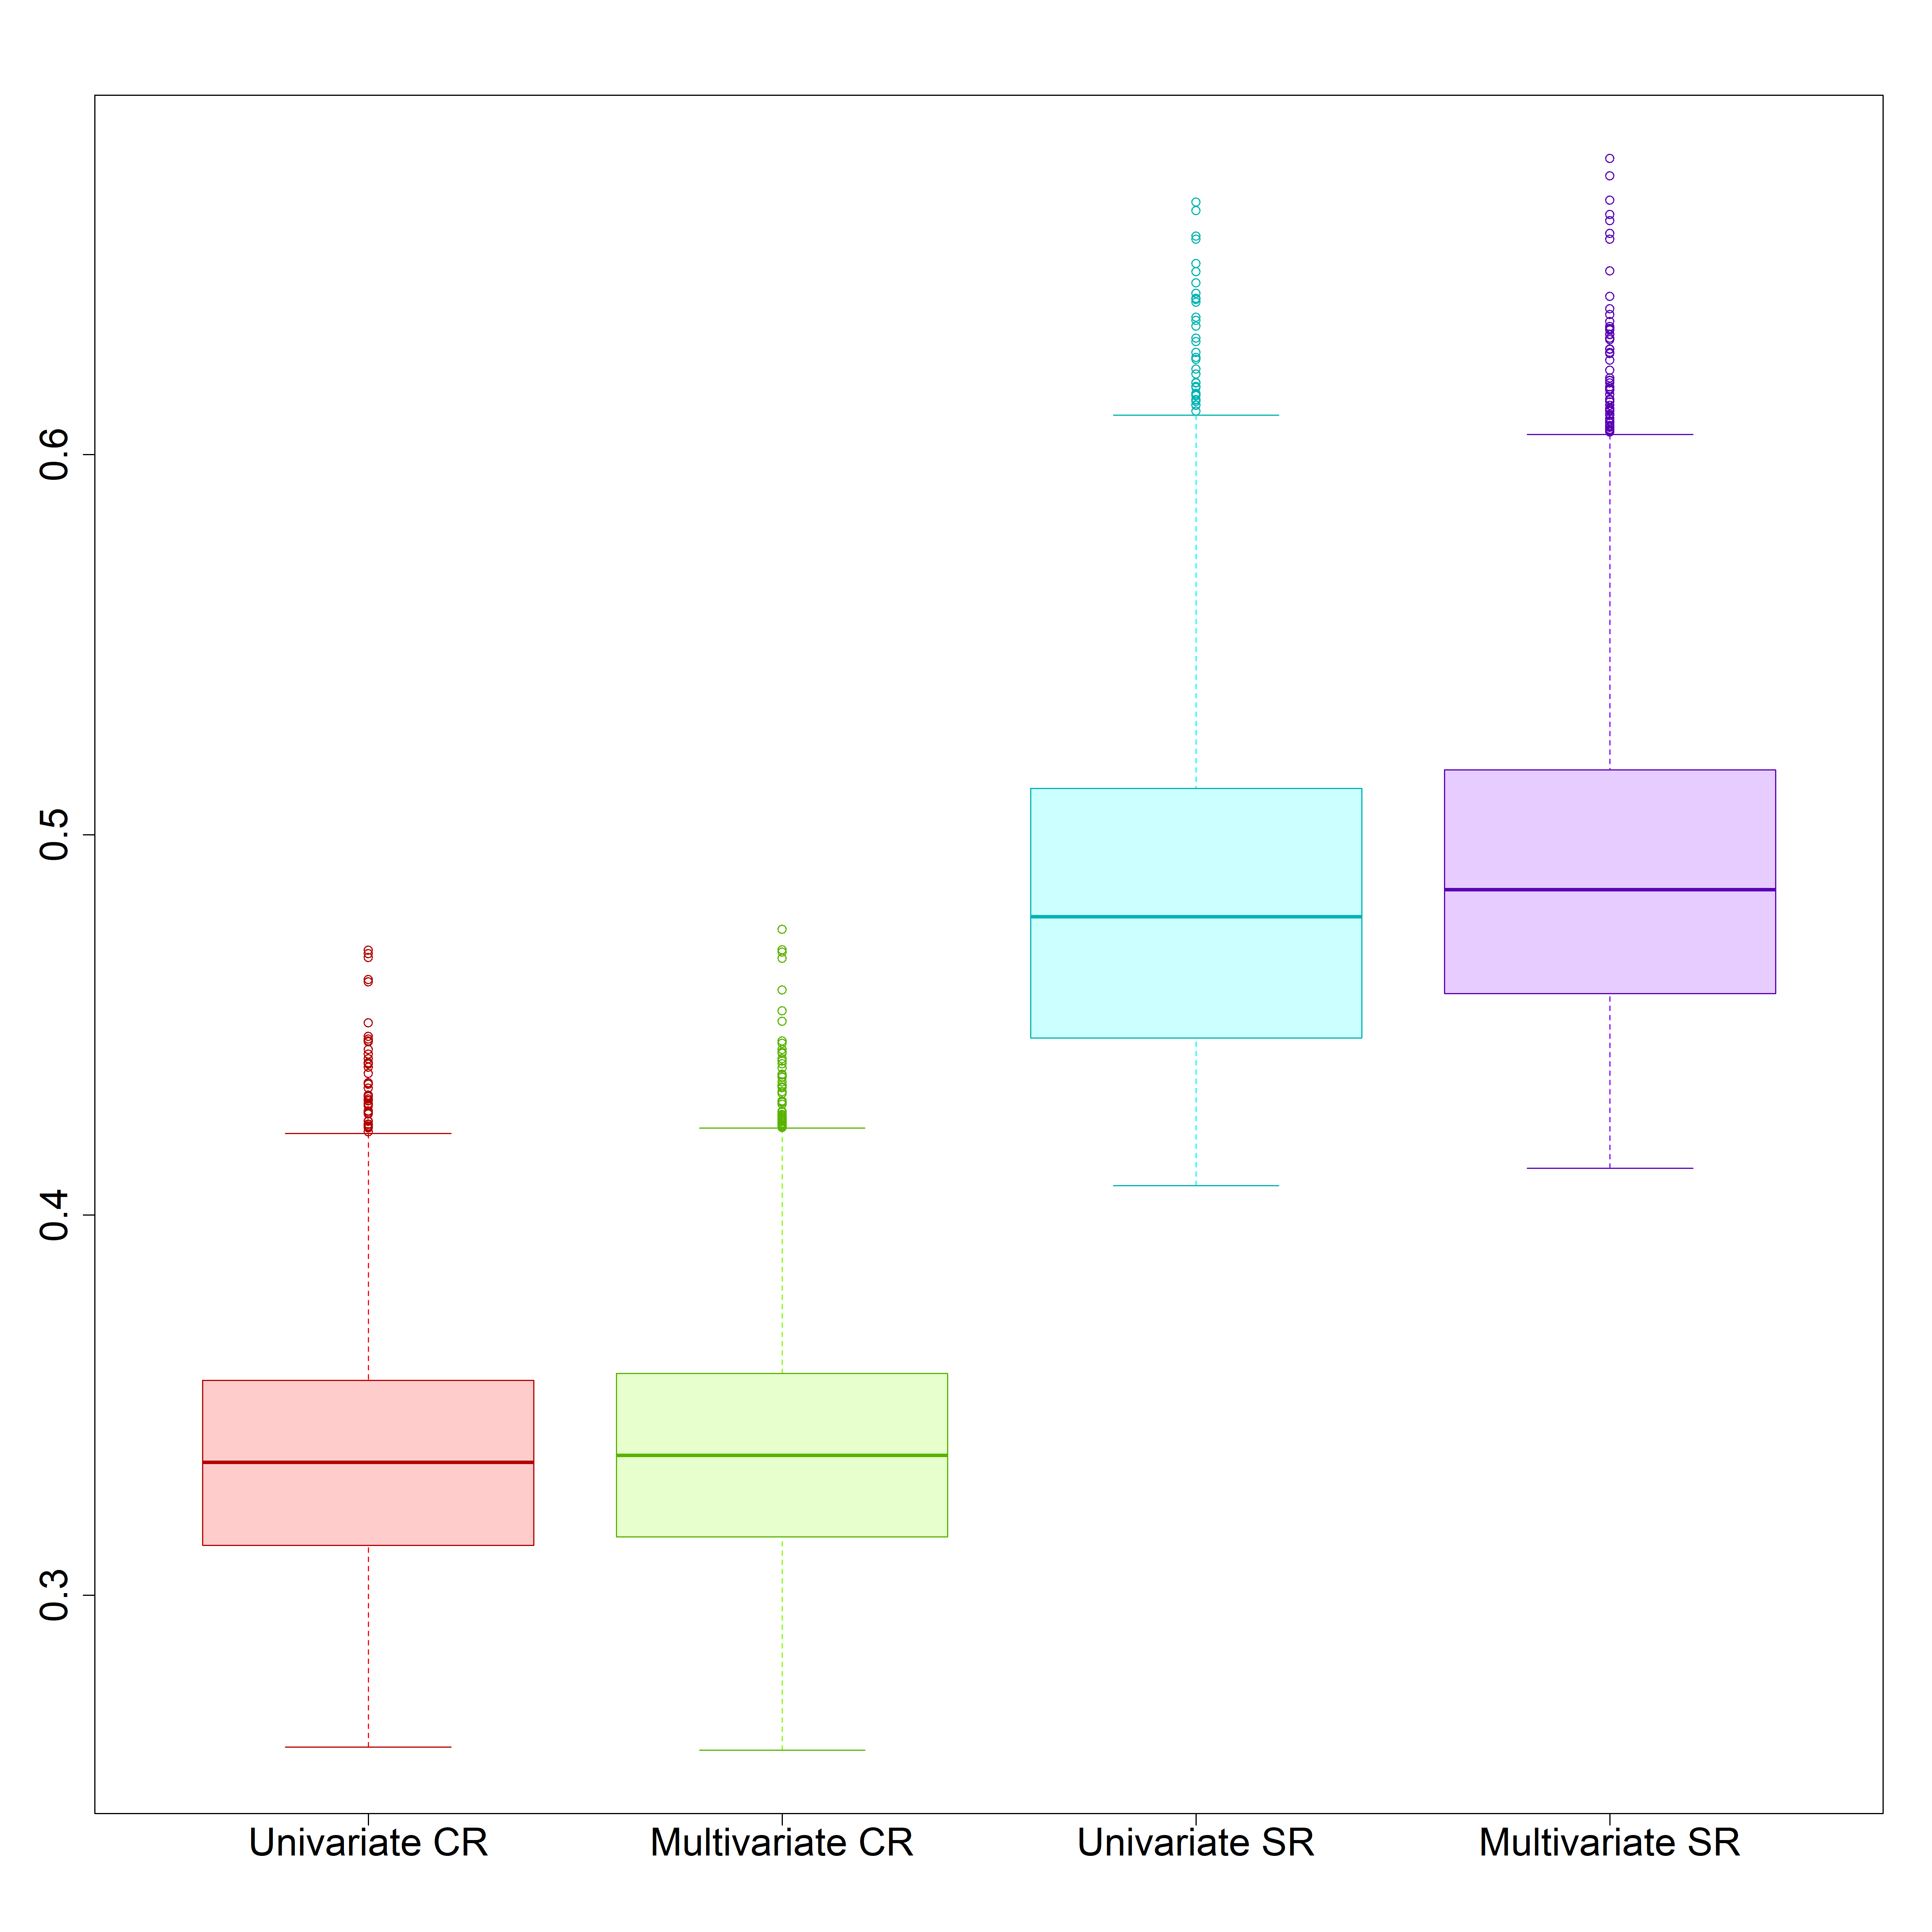
Comparison
Standard errors from 10,000 UVMA and MVMA on CR and SR
When there are no missing data, the multivariate model produces estimates similar to those obtainable with two separate univariate models.

Slide 18
… and if we have missing outcomes?

Slide 19
Missing data
Outcomes in the studies are Missing At Random (MAR)
CR and the SR outcomes are missing depending on the observed variable mean age of participants in the studies
Younger participants do not need clinical evaluation
Older participants are only evaluated by clinicians
36% of missing within-study correlations

Slide 20
Missing data
Study | Mean Age | Est CR | Est SR | SE CR | SE SR | Cor ws
1 | 68.77 | 5.12 | NA | 0.46 | NA | NA
2 | 58.59 | 2.57 | 2.13 | 0.44 | 0.70 | 0.57
3 | 31.48 | NA | 2.19 | NA | 0.68 | NA
4 | 56.78 | 6.39 | 6.59 | 0.48 | 0.74 | 0.61
5 | 58.95 | 4.09 | 3.57 | 0.43 | 0.71 | 0.63
6 | 67.76 | 2.42 | NA | 0.46 | NA | NA

Slide 21
Missing outcome multiple imputation
In addition to the multivariate analysis, we also explored if imputing the missing outcomes could be a viable option
Quartagno and Carpenter (2015) MI for IPD-MA with missing covariates
Suggested for other purposes in Viechtbauer (2010)
We use multiple imputation to impute the missing outcomes based on a linear regression model.
mice and metafor (van Buuren & Groothuis-Oudshoorn, 2011; Viechtbauer, 2010)
)

Slide 22
Comparison
 | Univariate |  | Multivariate |  | SEM |  | MI |  | Riley Method
Variable | Estimate | Std. Err. | Estimate | Std. Err. | Estimate | Std. Err. | Estimate | Std. Err. | Estimate | Std. Err.
CR | 3.257 | 0.223 | 3.296 | 0.201 | 3.298 | 0.200 | 3.298 | 0.201 | 3.259 | 0.208
SR | 3.403 | 0.232 | 3.328 | 0.208 | 3.328 | 0.203 | 3.327 | 0.203 | 3.353 | 0.21
 | Univariate |  | Multivariate |  | SEM |  | Riley Method
Variable | Estimate | Std. Err. | Estimate | Std. Err. | Estimate | Std. Err. | Estimate | Std. Err.
CR | 3.329 | 0.196 | 3.330 | 0.196 | 3.330 | 0.196 | 3.331 | 0.197
SR | 3.378 | 0.205 | 3.382 | 0.205 | 3.382 | 0.205 | 3.381 | 0.205

Slide 23
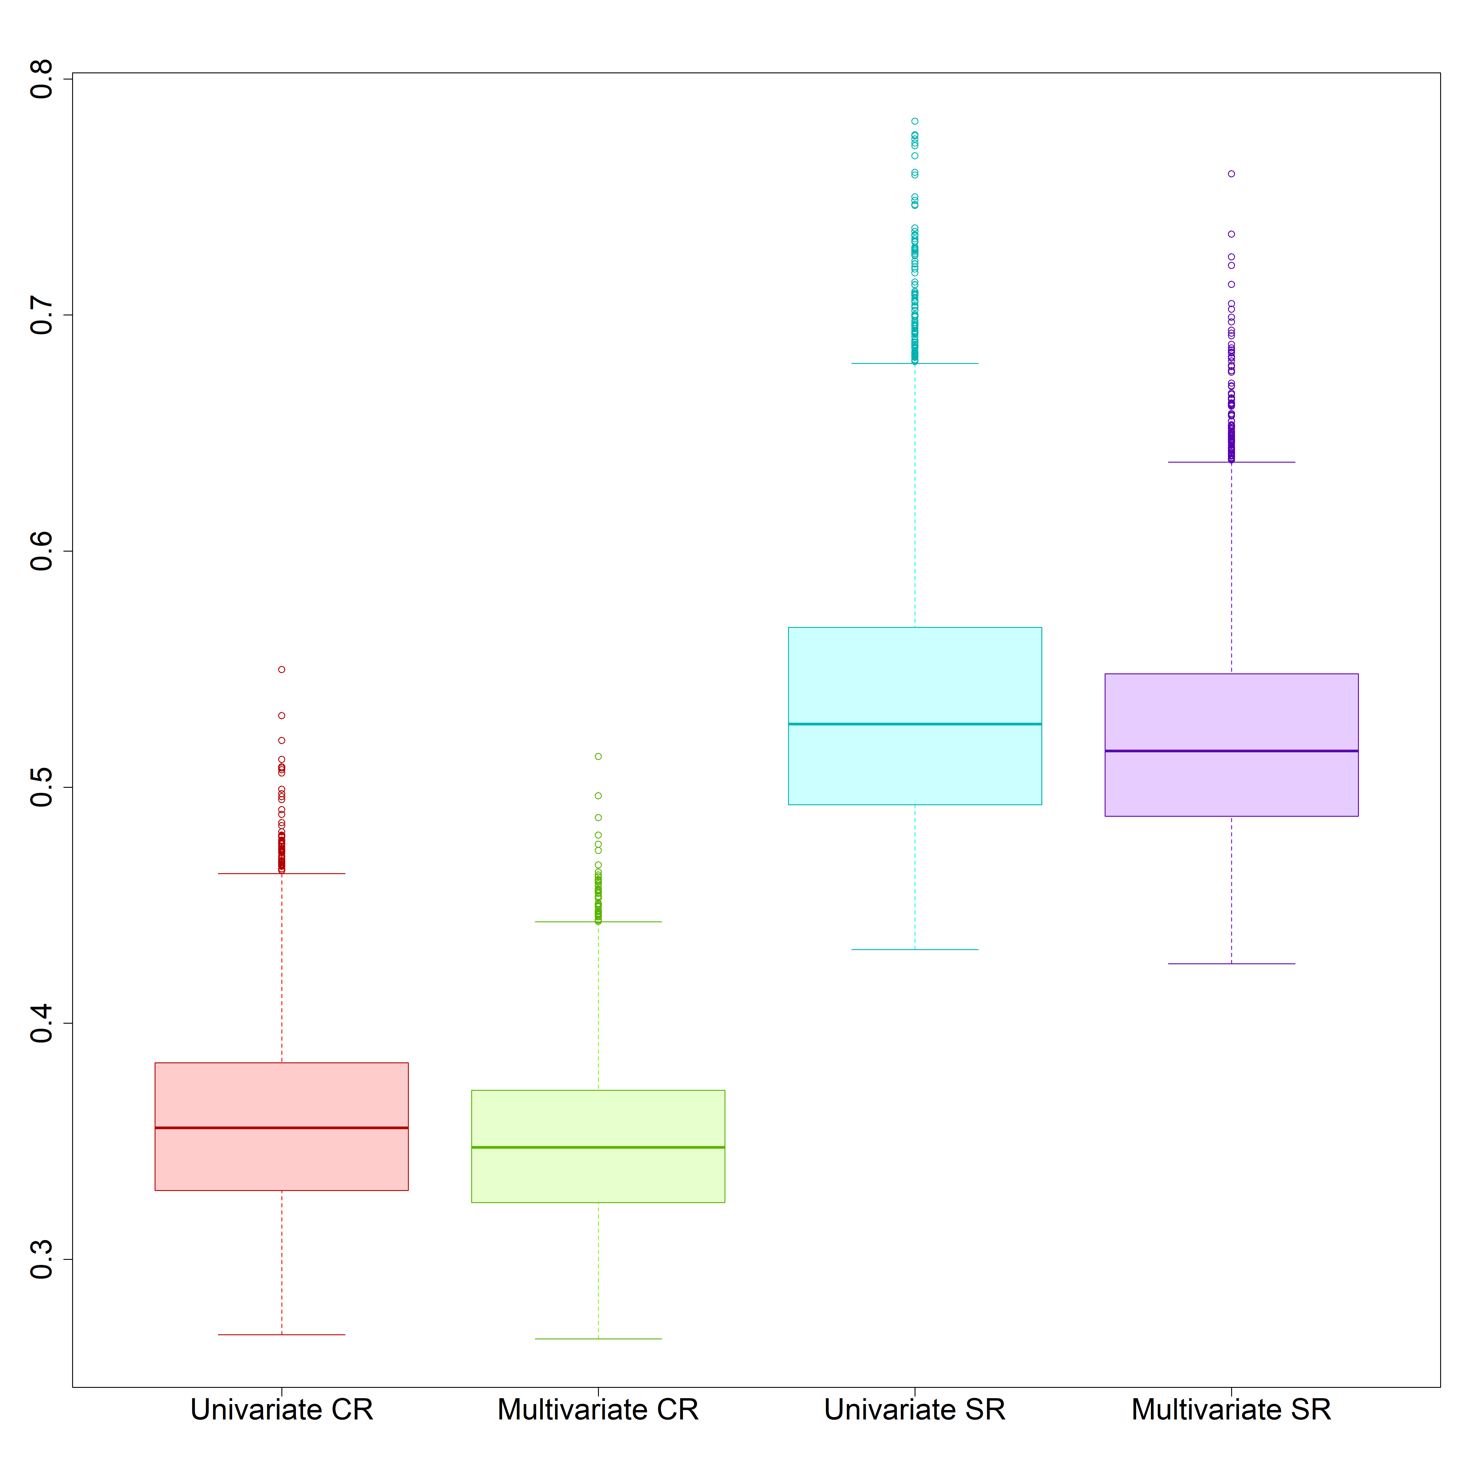
Comparison
Standard errors from 10,000 UVMA and MVMA on CR and SR
In presence of missing outcomes, the multivariate approach allows for borrowing of strength (Jackson et al., 2011; Riley et al., 2007). This leads to more precise estimates and smaller standard errors.

Slide 24
Real data

Slide 25
Real dataset
Cujipers et al. (2010) published meta-analysis on the differences between CR and SR depression measurements
The authors collect data from 48 studies that measure depression on both a clinician rating (Hamilton Rating Scale for Depression; HRSD) and self-report scale (Beck Depression Inventory; BDI)
Appendix A
Subset of 41 studies that present outcomes on HRSD and BDI

Slide 26
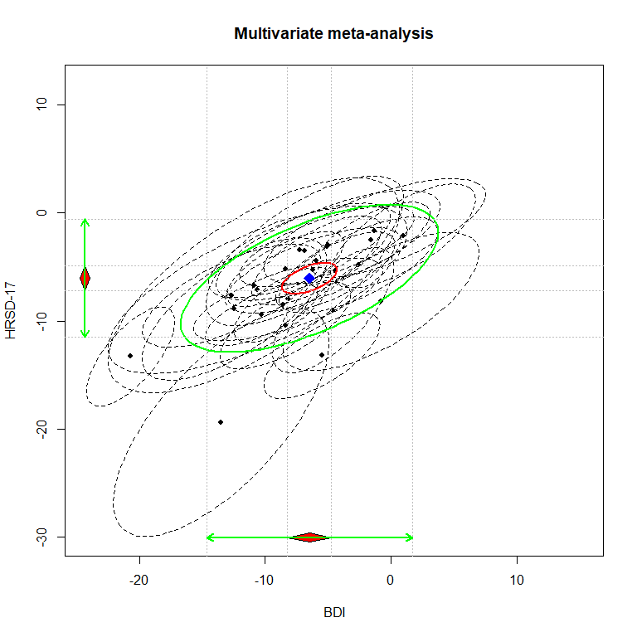
Results
 | Multivariate |  | SEM
Variable | Estimate | Std.Err. | Estimate | Std.Err.
BDI | −6.475 | 0.874 | −6.475 | 0.888
HRSD | −6.060 | 0.585 | −6.060 | 0.585

Slide 27
Comparison
 | Univariate |  | Multivariate |  | SEM |  | MI |  | Riley Method
Variable | Estimate | Std.Err. | Estimate | Std.Err. | Estimate | Std.Err. | Estimate | Std.Err. | Estimate | Std.Err.
BDI | −7.040 | 0.944 | −6.475 | 0.874 | −6.475 | 0.888 | −6.757 | 0.849 | −6.243 | 0.801
HRSD | −6.099 | 0.603 | −6.060 | 0.585 | −6.060 | 0.585 | −6.061 | 0.618 | −5.843 | 0.552

Slide 28
Summary of the results
Multivariate MA handles missing outcomes and provides more precise estimates
Multivariate MA and SEM MVMA produce consistent results
Multivariate MA with Riley Method with the Robust Variance Estimator leads to comparable results
Multivariate approach -> meaningful estimates
When there are no missing data, there is little gain from a multivariate approach

Slide 29
Limitations and future research
We performed a bivariate analysis; reality might be more nuanced
The use of aggregate data might introduce bias
Multiple Imputation of missing outcomes should be explored in major depth
Oversimplified situation, psychological MA might present studies on more scales
MAR assumption difficult to demonstrate
What about MNAR?

Slide 30
… and if we have missing not at random outcomes?

Slide 31
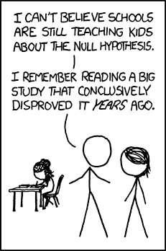
Missing At Random outcomes
Multivariate meta-analysis:
Missing by design (Riley, 2009)
Outcome Reporting Bias (Frosi et al., 2015)
Notes:
ORB: selection for publication of a subset of the original recorded outcome variables based on the results.

Slide 32
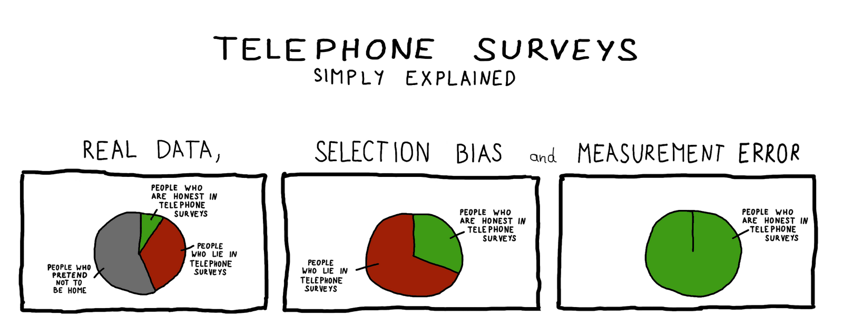
Missing Not At Random outcomes
Selectively unreported outcomes
Selection models (Heckman models)
Pattern-mixture models
http://question--everything.blogspot.com/2010/09/telephone-surveys-simply-explained.html

Slide 33
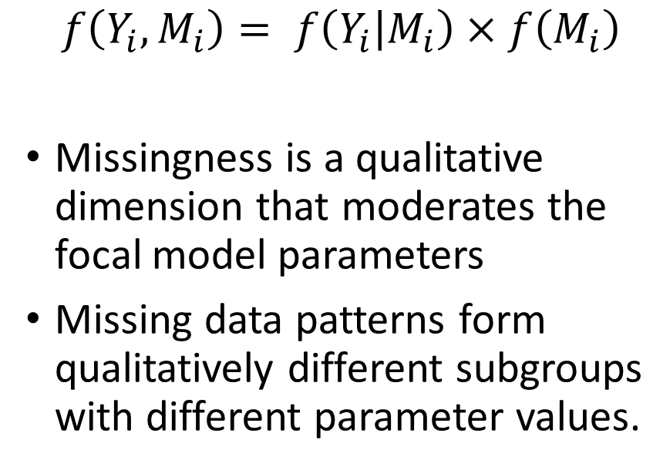
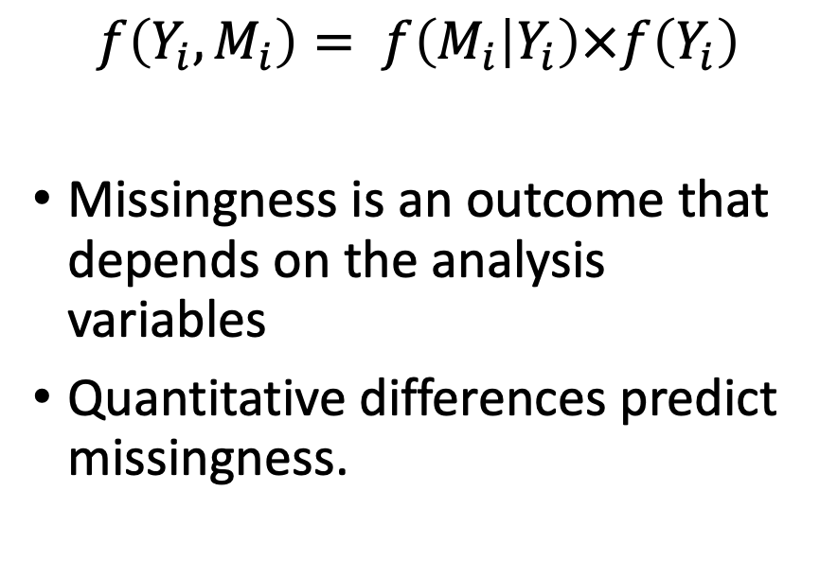
Missing Not At Random sensitivity analysis
Selection models
Pattern-mixture models
$$f\left(Y_{i}, M_{i}\right)= f\left(M_{i} | Y_{i}\right)×f\left(Y_{i}\right)$$
Missingness is an outcome that depends on the analysis variables
Quantitative differences predict missingness.
$$f\left(Y_{i}, M_{i}\right)= f\left(Y_{i} | M_{i}\right)×f\left(M_{i}\right)$$
Missingness is a qualitative dimension that moderates the focal model parameters
Missing data patterns form qualitatively different subgroups with different parameter values.

Slide 34
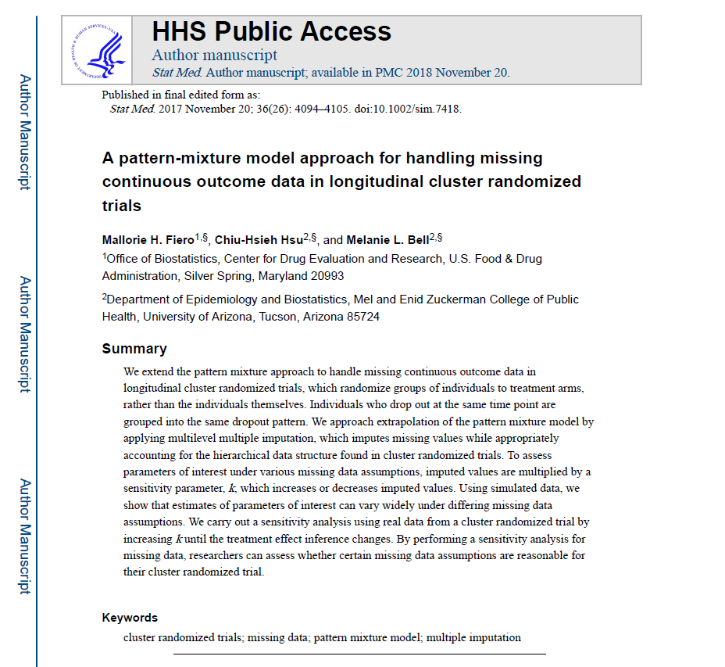
Pattern-mixture model sensitivity analysis (I)
Same IPD dataset
Complete case analysis
Created missing not at random data (10 %)

Slide 35
Pattern-mixture model sensitivity analysis (I)
Analysis assuming MCAR
Multilevel multiple imputation to obtain MAR imputed values
Analysis assuming MAR with Rubin’s rules
Sensitivity parameter and correction
Analysis with the MNAR imputed data

Slide 36
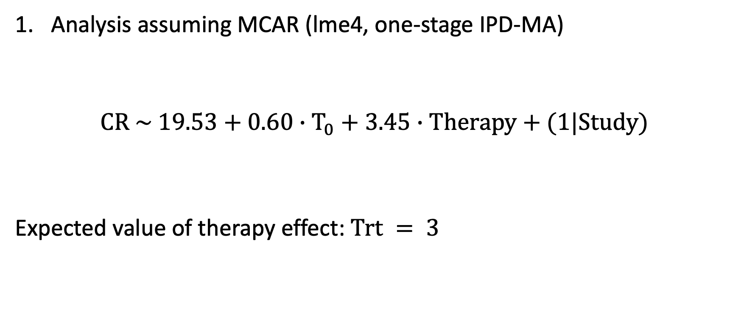
Pattern-mixture model sensitivity analysis (I)
Analysis assuming MCAR (lme4, one-stage IPD-MA)
$$CR \sim 19.53+0.60∙T_{0}+3.45∙Therapy+(1|Study)$$
Expected value of therapy effect: $Trt = 3$

Slide 37
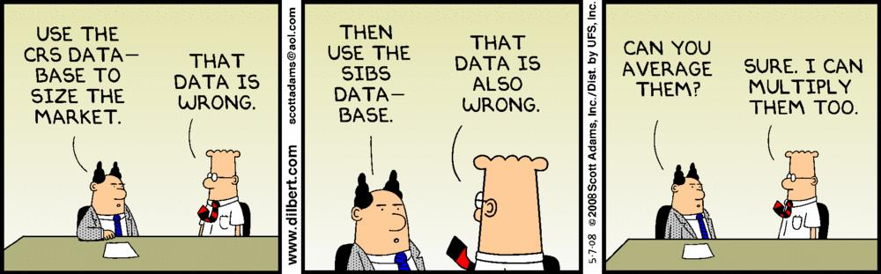
Pattern-mixture model sensitivity analysis (II)
Multilevel multiple imputation to obtain MAR imputed values
mice (van Buuren, 2011)
Method: 2l.lmer (imputation of continuous variable from a 2-level regression model)

Slide 38

Pattern-mixture model sensitivity analysis (III)
Analysis assuming MAR with Rubin’s rules
Expected value of therapy effect: $Trt = 3$
$$CR \sim 19.43+0.60∙T_{0}+3.44∙Therapy+(1|Study)$$

Slide 39

Pattern-mixture model sensitivity analysis (IV)
Sensitivity parameter and correction
We “fixed” just the missing outcomes.

Slide 40
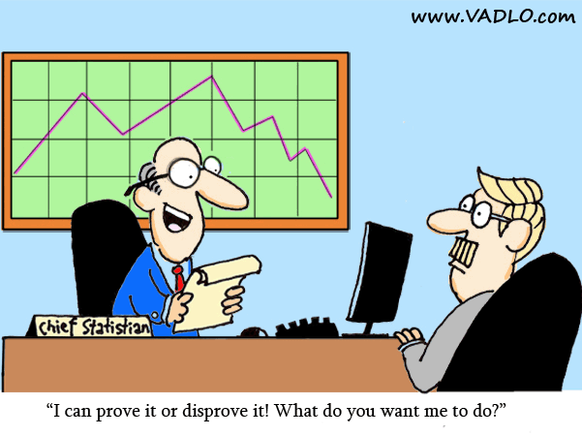
Pattern-mixture model sensitivity analysis (V)
Analysis with the MNAR imputed data
Per-protocol analysis (no lost to follow-up)
$$CR \sim 19.42+0.60∗T0+3.06∗Therapy+(1|Study)$$
$$CR \sim 19.72+0.60∗T0+3.10∗Therapy+(1|Study)$$

Slide 41
 | Multivariate MA | Univariate MA of SMDs
Context | The outcome of interest has been measured on different scales.
Rationale | Use the correlation between outcomes for a joint estimation | Pool measures in reason of their dimensionless
Benefits | Precise, nuanced and informed conclusions Reduces research waste Handles missing data | Straightforward Well-documented in the literature
Use | In case of correlated outcomes When not all the outcomes are reported on one instrument measure (i.e., scale) | Despite being widely adopted, given the methodological pitfalls, it should be used with caution. Highly correlated variables Little variability
Limitations | Difficulties in obtaining within-study correlations MAR assumption difficult to demonstrate Difficult when there are too many assessment instruments and the dataset is too sparse | Research waste ORB (Outcome Reporting Bias) Information loss Meaningless results

Slide 42

Thank you!
irene.alfarone@uibk.ac.at

Slide 43
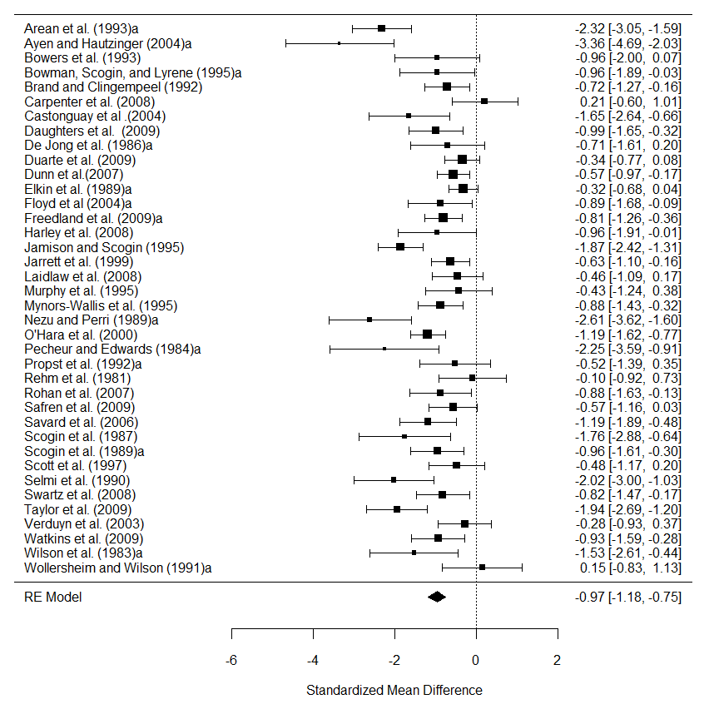
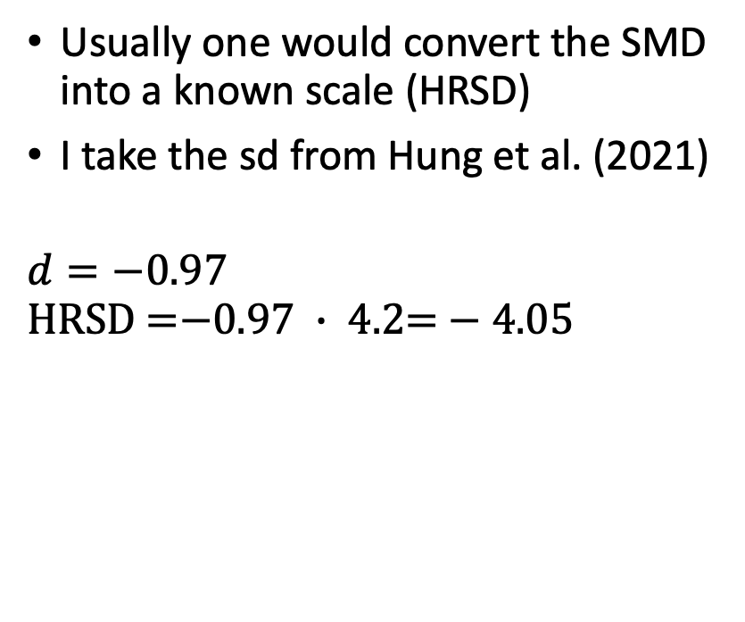
The standard way with Cujipers et al’s data
Usually one would convert the SMD into a known scale (HRSD)
I take the sd from Hung et al. (2021)
$$d=−0.97$$
$$\text{HRSD}\text{ =}\text{−}\text{0.97} ∙ \text{4.2= }\text{−} \text{4.05}$$

