Slide 1
Augmenting the Bayesian Ornstein-Uhlenbeck model for retest learning: simulation study
Riccardo Guidotti, Grace J. Chen, Zita Oravecz

Slide 2
Background

Slide 3
Measuring cognitive ability
We traditionally measure cognitive ability using single-shot assessments.
  Not designed to capture intra-individual variability in the short term
  Limited validity in ecological settings
Researchers increasingly use repeated, ultra-brief digital cognitive assessments, now feasible at scale on smartphones (Sliwinski et al., 2018)

Slide 4
PRACTICE EFFECTS!
Measuring cognitive ability
CAN YOU SPOT A PROBLEM?

Slide 5
The problem of learning effects
At the short and medium term, both practice and cognitive change move performance – the observed score is confounded!
  Retest gains can mask decline, or fake apparent improvement
Individual differences in learning is actually informative.
  e.g. Diminished practice effects predict later decline (Hassenstab et al., 2015)
In short, traditional testing schema cannot identify valuable sources of information (Nicosia et al. 2023)

Slide 6
An example: ADRD
In Alzheimer’s disease and related dementias (ADRD), there is a long preclinical phase before diagnosis.
Early-stage detection focuses mostly on biomarkers and cognitive assessments.
As Polk et al. (2025) point out, traditional neurospychological tests are largely blind to these preclinical changes
EMA-like designs can show evidence of early changes (Papp et al. 2025)
We can also relate this to biomarker changes.

Slide 7
Modeling retest effects
We argue here that we are able to capture these effects – thanks to the EMA measurement protocol
Oravecz et al. (2022) showed that the Bayesian double exponential model can separate practice from change in measurement burst design:
  One exponential for learning within a burst;
  Another for change across bursts.
Here: within-burst component

Slide 8
Statistical framework
We can model time-dependent observations (time series), broadly, in two ways:
  Discrete time models: spacing between occasions is fixed;
  Continuous time models: no such assumption, intervals have variable length
Here we propose a continuous time model with time-varying level: the Ornstein-Uhlenbeck + NEM

Slide 9
Key questions
How do we extract meaningful features of cognitive performance from each person’s high-frequency assessments?
How do we separate true cognitive ability from retest learning?
Our Approach: a Bayesian multilevel Ornstein–Uhlenbeck process with a negative exponential time-varying mean.

Slide 10
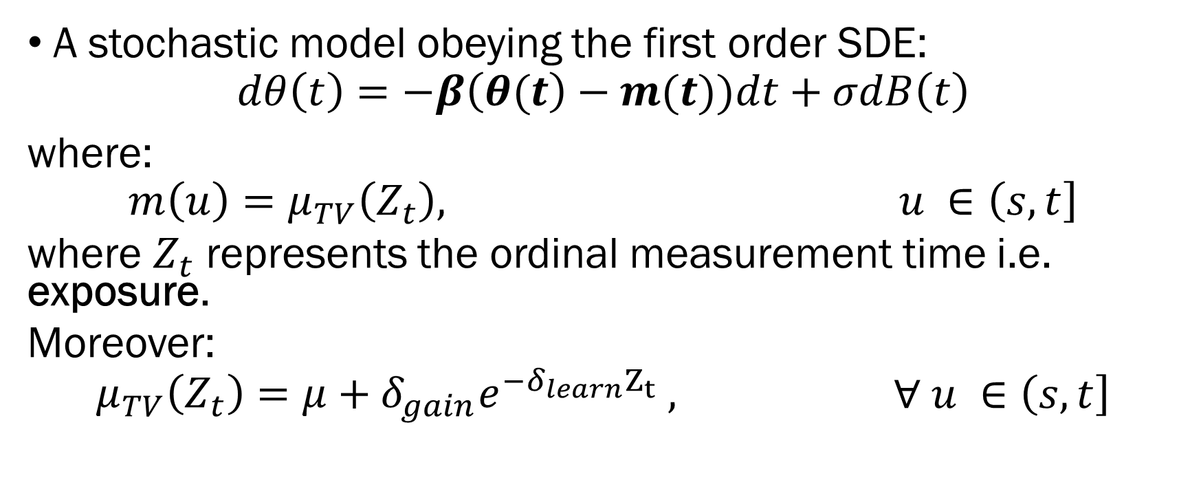
The model
A stochastic model obeying the first order SDE:
$dθ\left(t\right)=−β\left(θ(t\right)−m(t))dt+σdB\left(t\right)$
where:
$$\begin{aligned}m\left(u\right)=μ_{TV}\left(Z_{t}\right), u ∈\left(s,t\right]\end{aligned}$$
where $Z_{t}$ represents the ordinal measurement time i.e. exposure.
Moreover:
$$\begin{aligned}μ_{TV}\left(Z_{t}\right)=μ+δ_{gain}e^{−δ_{learn}Z_{t}} ,\end{aligned} ∀ u ∈\left(s,t\right]$$
$$β=attraction, μ=asymptotic level, δ_{gain}=performance gain, δ_{learn}=learning rate$$

Slide 11
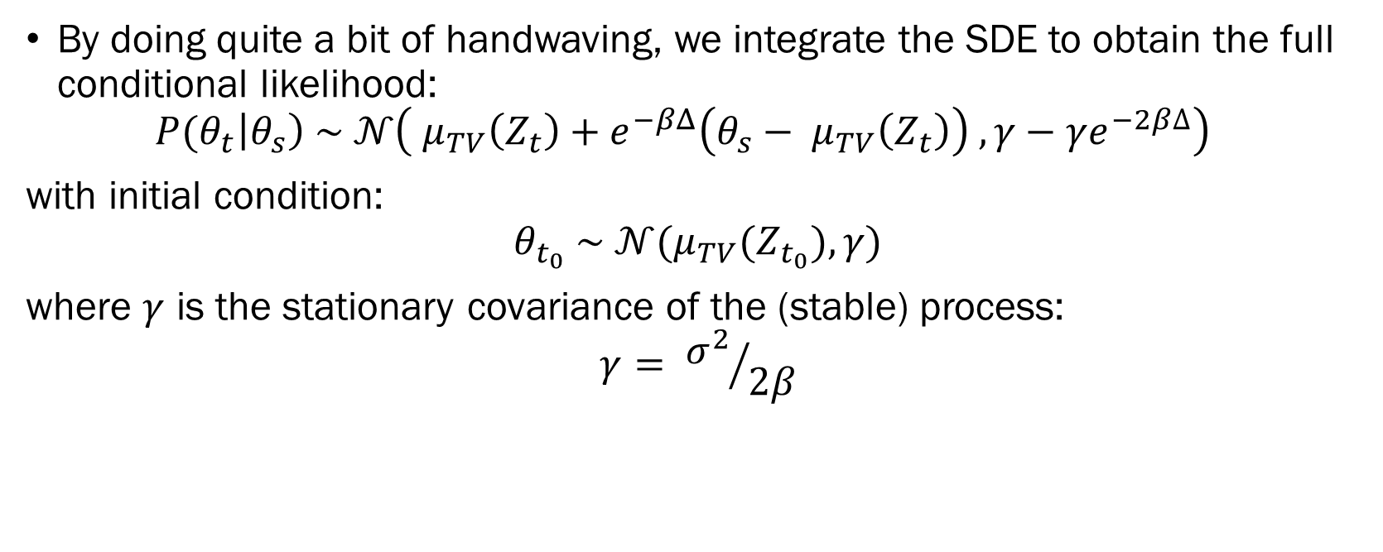
The model
By doing quite a bit of handwaving, we integrate the SDE to obtain the full conditional likelihood:
$\begin{aligned}{P(θ}_{t}\left|θ_{s}\right) \sim 𝒩\left( μ_{TV}\left(Z_{t}\right)+e^{−βΔ}\left(θ_{s}− μ_{TV}\left(Z_{t}\right)\right) , γ−γe^{−2β∆}\right)\end{aligned}$
with initial condition:
$$θ_{t_{0}} \sim 𝒩(μ_{TV}(Z_{t_{0}}), γ)$$
where $γ$ is the stationary covariance of the (stable) process:
$$γ= {σ^{2}}/{2β}$$

Slide 12
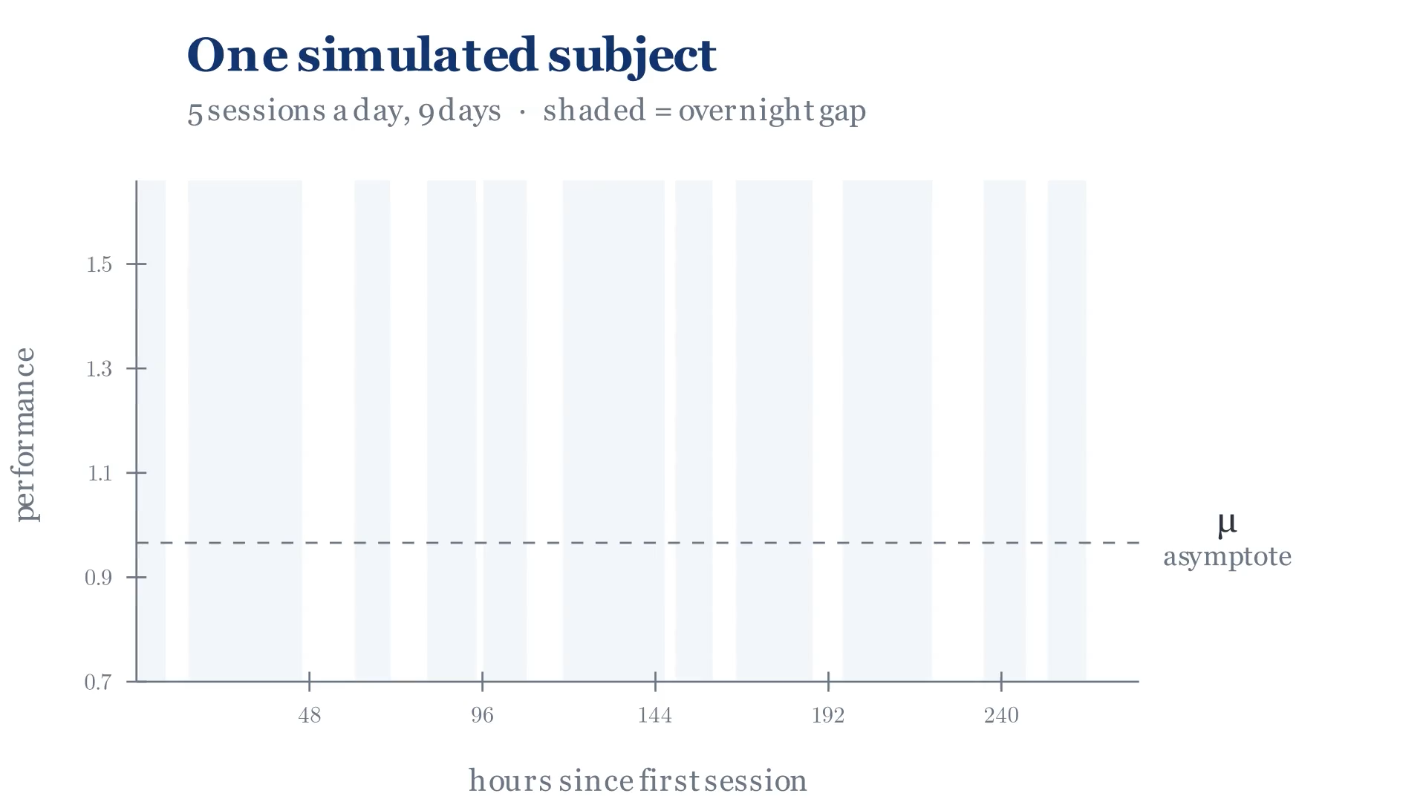
The model
In simpler terms, the process is attracted, at a person-specific rate, toward a mean that decays from an initial offset to an asymptotic level, fluctuating around it in the meantime.

Slide 13
The model
We adopted a Bayesian inference framework to:
  account for uncertainty in latent parameter estimates.
  correctly propagate estimates’ uncertainty via simultaneous parameter estimation.
We took the approach of using weakly informative priors for parameters (Gelman et al., 2014).

Slide 14
Methods

Slide 15
Measurement schema
SUBJECT N
SUBJECT 2
SUBJECT 1
OBS
DAY
OBS
DAY
OBS
DAY
…
…
…

Slide 16
Simulation approach
We used pyMC and Stan (via cmdstanpy) in Python 3.12.xx to write the model, using the nutpie backend for sampling.
We conducted Stan MC simulations across a 4x4 surface of subjects-observation pairs (PxO).
Each cell averaged results across 5 different seeds, each producing 4 chains with 5000 draws and 1500 tune-ins.
We evaluated coverage of truth values as well as computational efficiency.
Simulations were run on Penn State’s Roar Collab (ICDS): 80 model fits (4x4x5) as a 20-task Slurm array.

Slide 17
Simulation approach
The data generating process was informed using preliminary empirical data from the MindTrack study [6].
The reference task was “Color Shapes” from the M2C2 [1] suite of cognitive EMA tasks.
The target variable was response times in milliseconds.
We generated data using different number of hypothesized fixed covariates (0-8) of different strengths (Cohen’s ds).

Slide 18
Results

Slide 19
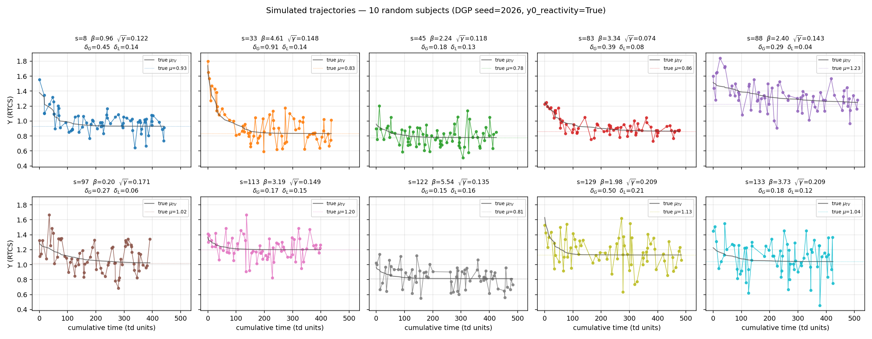

Slide 20
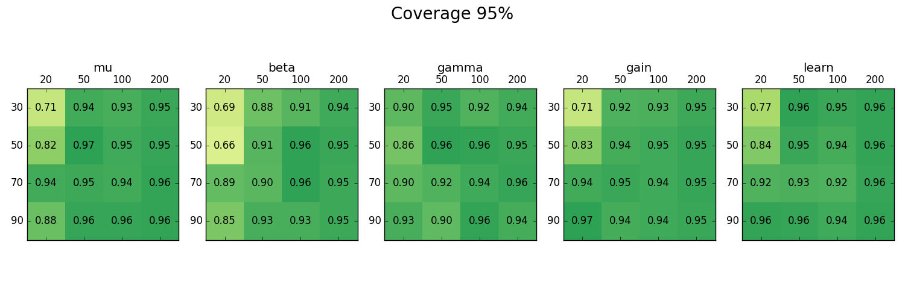

Slide 21
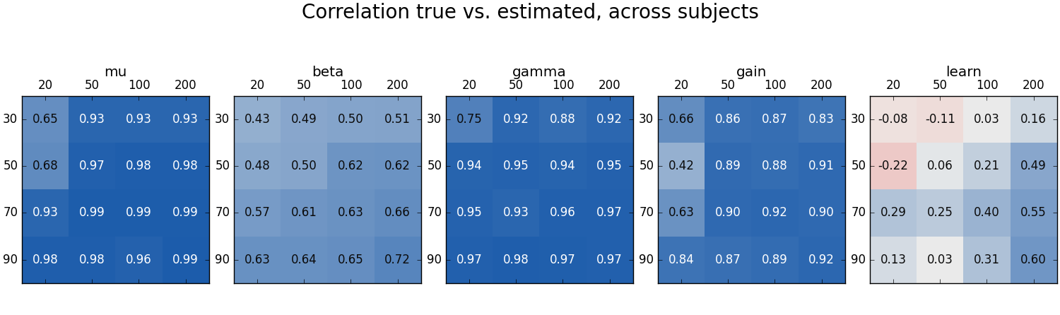

Slide 22
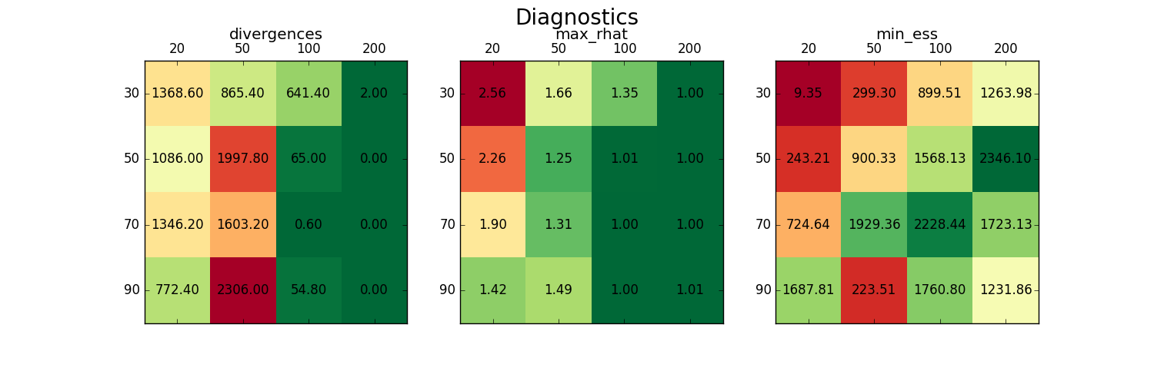

Slide 23
Discussion

Slide 24
Discussion - Takeaways
Stochastic models appear capable of characterizing longitudinal short term cognitive performance in RTCS tasks*.
This is relevant for monitoring cognitive profiles in subjects at risk of mental decline due to Alzheimer’s disease, as well as other conditions.
In healthy adults, we instead gain a more informative perspective on daily level of functioning to possibly connect with external factors (stress, subjective cognitive complaints, etc.)

Slide 25
Discussion – Future directions
The next steps are to:
  Expand the model using additional parameters across-burst (e.g. forgetting);
  Expand the model to multiple dimensions (Oravecz et al., 2016)
  Allow for time-varying covariates;
  Test model fit under different amounts of missing data (overall and within) and different missing mechanisms.

Slide 26
Discussion - Limitations
Learning parameter was the least recovered, limiting overall model fit;
Model coefficients are somewhat arbitrarily interpreted;
Bayesian framework requires careful choices, especially true for HMC.

Slide 27
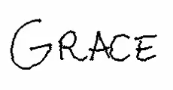
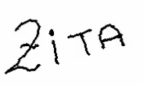
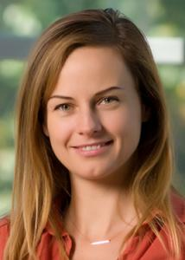
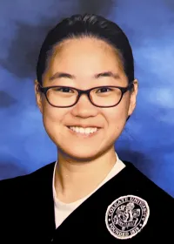
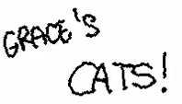
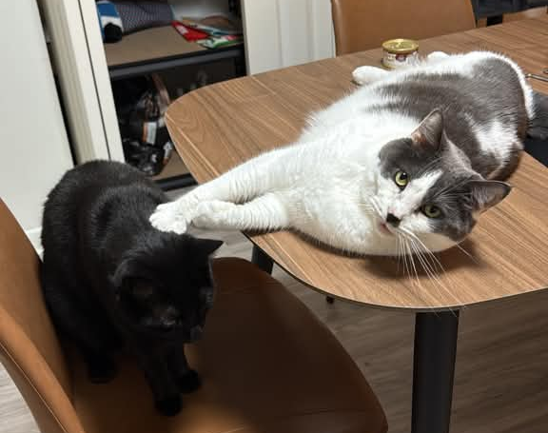
Wonderful people I worked with

Slide 28
THANK YOU!
ANY QUESTIONS?

